Slide 1
Elementary Graph Algorithms
CLRS Chapter 22.1-2

Slide 2
Graphs
How do you represent a road map?
There are cities, roads connecting them.
Some roads are two-way, some are one-way
We use the notion of a graph G=(V,E)
V= vertices (cities), E=edges (roads)
Two-way roads: undirected one way roads: directed

Slide 3
Graphs: Undirected Example
G=(V,E), undirected graph
V={a, b, c, d, e, f}
E={(a,b), (a,e), (a,f), (b,f), (c,d), (c,e)}
If (a,b) is an edge, so is (b,a)
a
b
c
d
e
f

Slide 4
Graphs: Directed Example
G=(V,E), directed graph
V={a, b, c, d, e, f}
E={(a,b), (a,f), (c,e), (d,c), (e,a), (f,b)}
If (a,b) is an edge, so is (b,a)
a
b
c
d
e
f

Slide 5
Representation: Adjacency Matrix
Use nxn matrix (n = |V|)
If edge (u,v) exists for u≤v, entry (u,v) = 1 else 0
No need to use half of matrix if G undirected (why?)
Space is O(n²), access time O(1)
Good if graph is dense
 | a | b | c | d | e | f
a | 0 | 1 | 0 | 0 | 1 | 1
b |  | 0 | 0 | 0 | 0 | 1
c |  |  | 0 | 1 | 1 | 0
d |  |  |  | 0 | 0 | 0
e |  |  |  |  | 0 | 0
f |  |  |  |  |  | 0
a
b
c
d
e
f

Slide 6
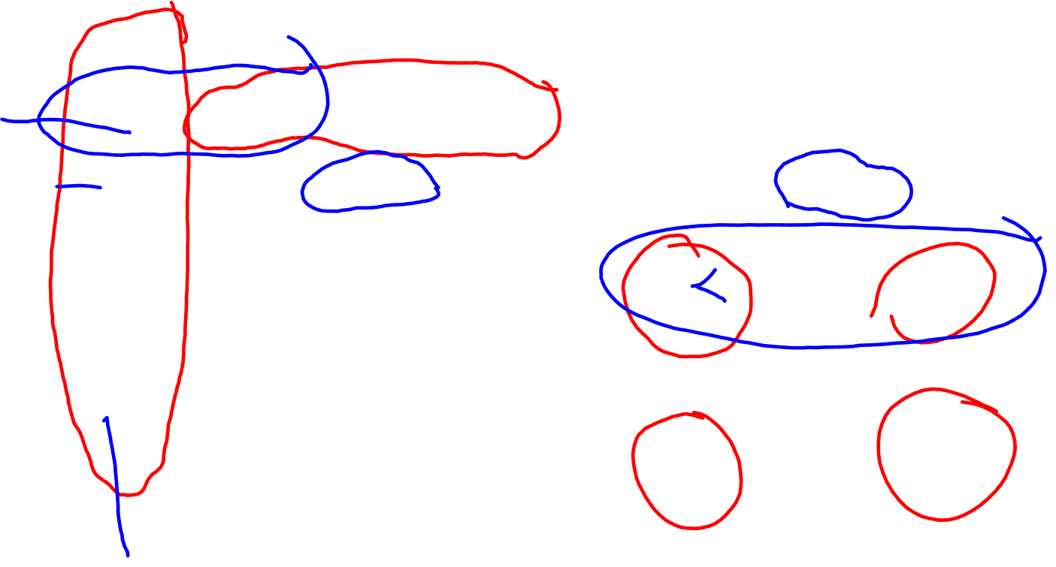
Representation: Adjacency List
vertex
a
b
c
d
e
f
e
Good for sparse graphs.
Access time can be linear,
Storage is O(m+n)
b
f
f
a
e
d
c
a
b
a
c
d
b
a
e
f

Slide 7
Graph Search
We would like to start from one vertex and explore all the vertices and edges of G
Can be done in linear time: O(m+n)
We will see two techniques: Breadth-First, and Depth-First Search

Slide 8
Breadth-First Search (BFS)
Input: G(V,E) and a starting vertex s
Explores every vertex and every edge.
First looks at vertices one hop away from s, then two hops, etc.
Produces a “breadth-first search tree” T, rooted at s.
The path from s to any other vertex in T is the shortest path.
Running time: O(m+n)

Slide 9
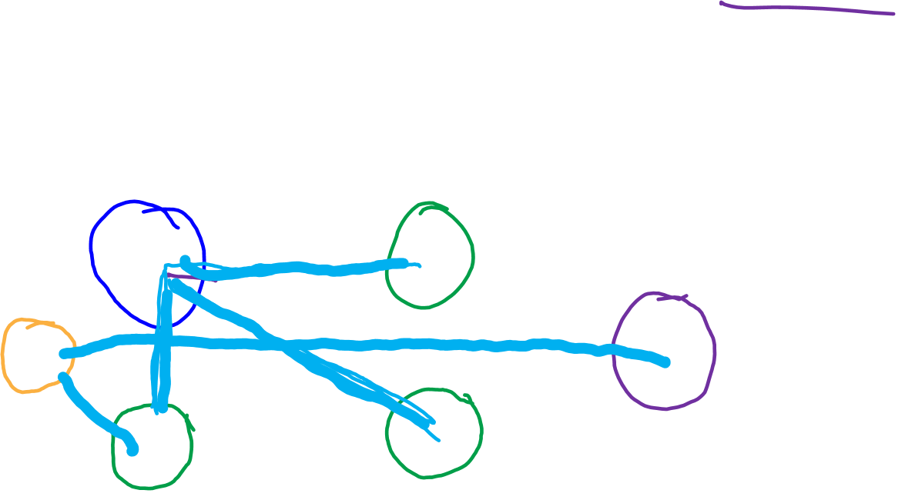
Breadth First Search (s=a)
a
b
c
d
e
f

Slide 10
Breadth-First Search (BFS)
Each vertex has a color B, G, W.
W is unexplored (initially all vertices are W)
B is fully explored (at the end all are B)
G is discovered but not finished
Distance: Distance to s (initially all set to infinity, except s)
Predecessor: next vertex on path to s
When a vertex is discovered:
Color it G, insert into FIFO Queue
When vertex is popped from queue, explore its W neighbors

Slide 11
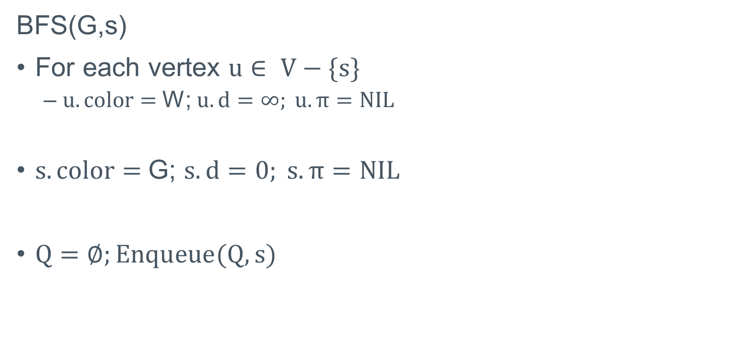
BFS: Initialization
BFS(G,s)
For each vertex $u∈ V−\{s\}$
$u.color=$W; $u.d=∞; u.π=NIL$
$s.color=$G; $s.d=0; s. π=NIL$
$Q=∅;Enqueue(Q,s)$

Slide 12
BFS, cont’d
While Q not empty
u =DEQUEUE(Q)
For each neighbor v of u:
if v is W then:
Color v as G
v.d = u.d +1
v.π = u;
ENQUEUE(v)
After all neighbors are processed, color u as B

Slide 13
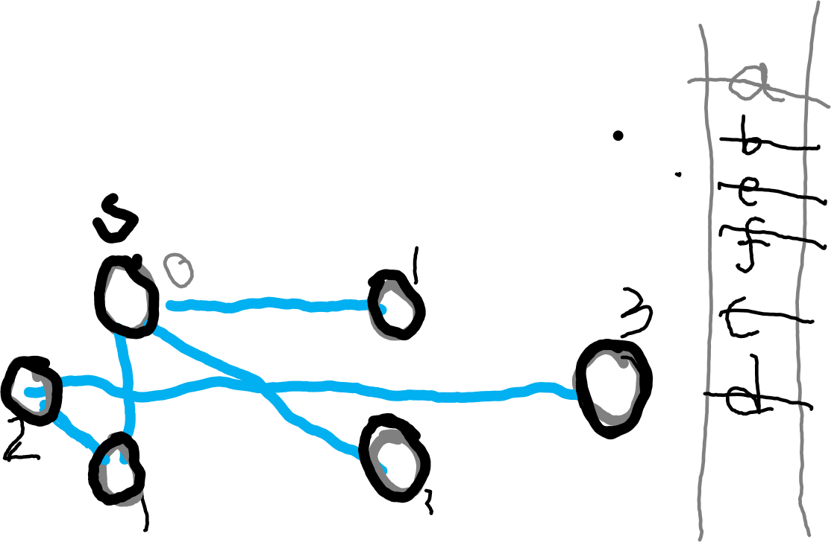
Breadth First Search (s=a)
a
b
c
d
e
f

Slide 14
BFS: Complexity analysis
We use adjacency list. Why?
Time complexity is the same as data structure (adjacency list, O(m+n))

